Slide 1
Role of the public health nurse in Preparedness and Response
Angela Callicutt, MSN, RN, CPHN, CPHQ
Assistant Director of Nursing, Office of the Chief Public Health Nurse
October 3, 2023

Slide 2
What we will cover today
Public Health Nurses’ Role and Functions
What Role Does Public Health Nursing Play in Preparedness and Response
Unique competencies of Public Health Nurses
NC Division of Public Health Level Support for Public Health Nurses

Slide 3
Health Promotion and Protection
Emergency Preparedness
Disaster Recovery
Environmental Safety and Quality
Clinical Interventions
Care Coordination
Cross Sector Collaboration
Community Engagement
Research
Public Health Nursing’s Eight Roles & Functions
POLICY
& ADVOCACY
Notes:
Eight Roles and Functions of PHNs

Slide 4
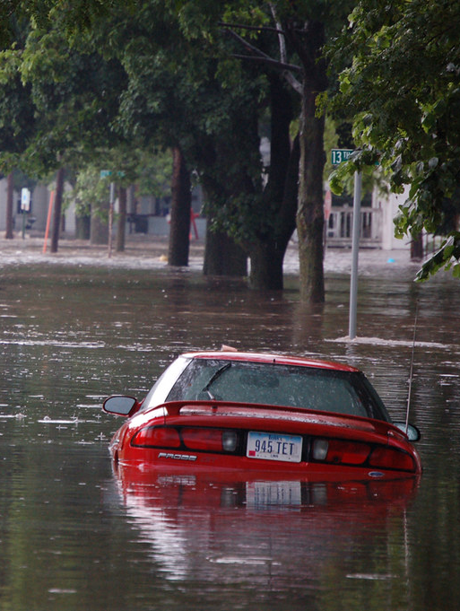
Examples of Emergency Preparedness and Disaster Recovery
Emergency & disaster sheltering
Epi Team exercises
Epi surveillance and detection
Educating patients and communities to decrease risk of infection or exposure during a pandemic or disaster
Notes:
Disaster and emergency are used interchangeably whenever a situation calls for crisis response however there is a distinction. Emergencies can be handled with resources routinely available to the community aid disaster calls for a response that exceeds local capabilities federal state and local systems all work together to address disasters.
The issues rooted in the social determinants of health also create increased vulnerability and disasters. Public health nurses are part of developing emergency operation plans especially related to related to sheltering working to prevent public health emergencies through the control of communicable diseases we participate in response drills and are equipped to provide pre i& post nuclear event prophylaxis..

Slide 5
National Guidance for Public Health Nursing Roles
https://www.phnurse.org/assets/docs/Role%20of%20PHN%20in%20Disaster%20PRR_APHN%202014%20Ref%20updated%202015.pdf

Slide 6
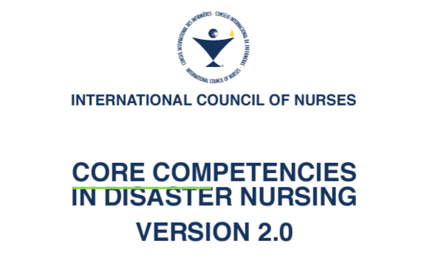
https://www.icn.ch/sites/default/files/inline-files/ICN_Disaster-Comp-Report_WEB.pdf

Slide 7
Public Health Nursing Unique Skills
Disaster Preparedness and Response: Knowledge of disaster management principles, understanding the phases of disaster response
Public Health Knowledge: Strong understanding of public health principles, population health, epidemiology, communicable disease control, environmental health, and health promotion.
Emergency Medical Care: Proficiency in providing basic medical care and first aid in emergency situations, such as wound care, CPR, and administering necessary medications.
Assessment and Triage: Ability to quickly assess the health needs of individuals in the shelter, prioritize care based on the severity of their conditions

Slide 8
Public Health Nursing Unique Skills
Health Education and Communication: Effective communication skills to educate individuals in the shelter about health and safety measures, disease prevention, and proper hygiene practices.
Cultural Competence: Sensitivity and understanding of diverse cultures and populations in the shelter, as well as the ability to adapt care strategies accordingly.
Collaboration and Teamwork: Capacity to work collaboratively with other disaster response teams, healthcare professionals, and volunteers in the shelter.
Logistics and Resource Management: Ability to manage limited resources effectively and make appropriate decisions regarding medical supplies, medications, and equipment.
Psychological Support: Awareness of the psychological impact of disasters on individuals and communities, and the ability to provide emotional support and referrals to mental health services.

Slide 9
Role of the Public Health Nursing in Sheltering
Surveil for illness and communicable disease
Assess and triage shelter resident population
Use critical thinking, nursing process, and crisis management skills
Provide case management for shelter resident population
Support and maintain shelter residents’ whole health
Implement infection control, quarantine, and isolation of suspected illness
Use innovative design to fill resource gaps and safeguard a healthy population
Function as critical part of shelter operations management

Slide 10
Management of the Shelter Environment and Health of Shelter Residents
Shelter management is necessary to meet the needs of those residents needing shelter but to also maintain a healthy environment.
Clinical health care may be provided by other disciplines but assessing and promoting population health is the role and function of the public health nurse.
Notes:
-Residents arrive in the shelter with complex needs that requires a consideration of the whole person, including social determinants of health/ individual needs, health inequity, and inclusion. While other disciplines may provide direct patient care and triage, the role of the public health nurse is to assess for communicable diseases, surveillance for infectious diseases, promote and support population health in shelter operations, assist in design and input on shelter layout, implement and design quarantine and isolation protocols or decisions, manage and design infection control processes, and care management of the population.

Slide 11
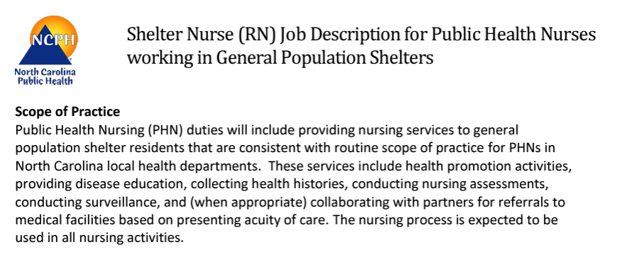
www.dph.ncdhhs.gov/lhd/docs/ShelterPHNJobDescription.pdf

Slide 12
Staffing Matrix
Shelter Staffing | Up to 199 clients |  | 200- 499 clients |  | 500 CLIENTS
PHN | 1 | 1 | 1 | 1 | 2 | 2
Public Health Nurse or OEMS Provider | Day | Night | Day | Night | Day | Night
 | 2 | 2 | 3 | 3 | 4 | 4

Slide 13
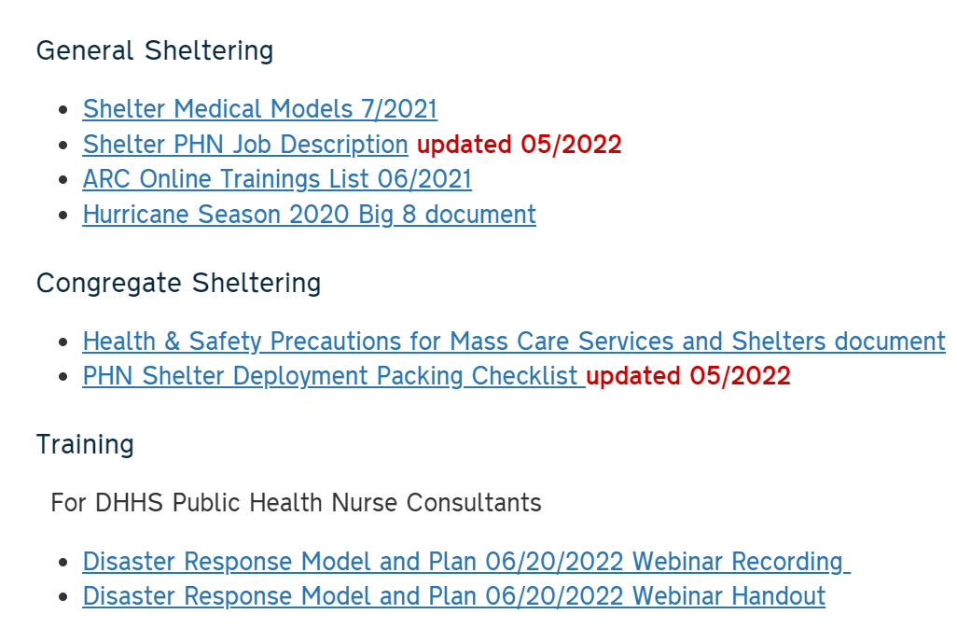
Shelter Models and Resources
https://www.dph.ncdhhs.gov/lhd/

Slide 14
DPH PHNC Roles During Disasters
Nursing Response Activities
LTAT Command Center (LTATCC)
OCPHN Staff
RNs assigned from other Sections
Critical Response Roles
Communicable Disease Nurse Consultants
Immunization Branch Nurse Consultants
State Maternal Health Nurse Consultant
Deployment to Shelter
Remaining nurses may volunteer for a 5–7-day deployment to a county
Notes:
Any Nurse Consultant that meets the requirements in the General Population Shelter RN job description may sign-up for shelter surge capacity if approved by Branch Head. Branch Head will alert Chief Nurse if a Nurse Consultant is deployed to a shelter. Creation of a profile in NC Terms will be required to facilitate deployment logistics. Please note if you want your home county shelter.
Status Check Nurses Serve from assigned office or home office as part of the NCDHHS PHNC Disaster Response Plan
Excluded PHNCs
Communicable Disease and Immunization Branch Nurses due to assigned critical duties
The State Maternal Health Nurse Consultant due to needing to be available to take calls directly from Lead Shelter Nurses regarding pregnant women being housed in shelters

Slide 15
OCPHN Leaders Support PH Command Center ESF 8 Desk ICS Emergency Support Function 8 – Public Health and Medical Services
Provide nursing practice, nurse deployment, and solutions in real-time as part of the PHCC
Assist in advising on roles and functions and staffing models
Assist in Nurse Deployment
Available when the PHCC is in operation
Liaise with LTATCC

Slide 16
Why The LTATCC Was Developed
Hurricane Florence, lived experience
Built on National Nursing Support Models
Notes:
OCPHN-created to address existing gaps in state-level support for local PH nurse leaders in affected counties. Gaps included the absence of
Assistance in critical thinking to support their nursing role
Support in innovation for infection control in the absence of running water until resources could be deployed
Assistance in critical thinking for placement of individuals within the shelter for isolation and quarantine of illness,
Assistance in solutions resource needs until request could be filled
Access to mental health support for deployed nursing staff and nurse leaders
Addressing deployed nursing staff issues/ safety concerns

Slide 17
LTATCC
Functions to facilitate clear, consistent and on-time communication between local health departments, LTATCC, the PH Command Center, and Emergency Operations Center.
Adds real-time, on-demand connection to subject matter experts and nurse-to-nurse support.
It’s this.

Slide 18
Goal and Purpose of the LTATCC
Support PH nurse leaders when shelters are opened in their county
Support deployed mutual aid and EMAC nurses
On-demand, consistent, live support to assist the nurse in performing their role
On-demand technical assistance and communication of needs of the shelter to PHP&R, NCEM
On-demand touchpoint to address the health and safety of deployed nurses
On-time orientation and direction for deployed nurses

Slide 19
LTAT Command Center - How We Do It
A Nurse Consultant is assigned to support the nursing leadership of each shelter as soon as LTAT is notified the shelter is open
Daily check-in with each shelter nurse leader
Direct communication to PHP&R and NCEM
Deployed nurse support ( Mutual Aid and EMAC)

Slide 20
LTATCC/PHNC Response Plan & Model
PHP&R and LTATCC work through the Resource Request
PHP&R Assigns EMAC PHNs
PHP&R gives PHNs their deployment orders
5. Upon arrival to shelter location, PHNs check-in with Status Check Nurse (phone call and text)
1. PHP&R shares information with LTATCC Nurse Lead
5. Upon arrival to shelter location, PHNs check-in with Status Check Nurse (phone call and text)
1. PHP&R shares information with LTATCC Nurse Lead
1. PHP&R shares information with LTATCC Nurse Lead
1. PHP&R shares information with LTATCC Nurse Lead
2. LTATCC Nurse Lead assigns a PH Nurse Consultant to deployed EMAC PHN team
6. LTATCC Nurse Lead shares check-in information with PHP&R
2. LTATCC Nurse Lead assigns a PH Nurse Consultant to deployed EMAC PHN team
2 LTATCC Nurse Lead or designee nurse contacts EMAC PHN team and schedules orientation
3. LTATCC Nurse Lead contacts EMAC PHN team and conducts orientation
7. Status-Check Nurse make calls to PHNs daily at pre-determined time (set during first Status-Check/EMAC PHN call)
3. LTATCC Nurse conducts EMAC PHN team and orientation
4. LTATCC Nurse Lead assigns PH Nurse Consultant(s) as Status Check Nurses
8. Once nurses have left the shelter, tracking their return to home will fall to PHP&R
Orientation Nurses and Status-Check Nurses will report contacts and any issues to LTATCC Nurse Lead in timely fashion: SAFETY CHECK!

Slide 21
LTATCC/PHNC Response Plan & Model Local DON Status-Check Process
Local DONs
Receive Daily Call from DON Status Check Nurse
DON Status-Check Nurse sends written report to LTATCC Nurse Lead (or designee) by 10 a.m.. LTATCC Nurse Lead reports out to PHP&R @ 11 a.m. call

Slide 22
LTATCC/PHNC Response Plan & Model EMAC RN Orientation and Status-Check Process
Receive Orientation at Staging Area (out of state nurses) or virtually (NC PHNs) by LTATCC Nurse Lead
EMAC nurse given contact cell phone number and
assigned a Status-Check Nurse
Upon arrival to shelter, EMAC Nurse will check-in with Shelter Manager, Shelter Charge Nurse and call Status Check Nurse (determine time for daily check-in calls)
Status-Check Nurse sends written report to LTATCC Nurse Lead (or designee) by 10 a.m.. LTATCC Nurse Lead reports out to PHP&R @ 11 a.m. call
Receive 1st call from Status-Check Nurse (& then at least one call each day

Slide 23
Resources
American Nurses Association (2022). Public health nursing: scope and standards of practice, 3rd edition
Association of Public Health Nursing (2015). The Role of the Public Health Nurse In Disaster, Preparedness, Response and Recovery. https://www.phnurse.org/assets/docs/Role%20of%20PHN%20in%20Disaster%20PRR_APHN%202014%20Ref%20updated%202015.pdf
International Council of Nursing (2019). Core competencies in disaster nursing version 2 - ICN. https://www.icn.ch/sites/default/files/inline-files/ICN_Disaster-Comp-Report_WEB_final.pdf
NC Division of Public Health (n.d.) For Local Health Departments, https://www.dph.ncdhhs.gov/lhd/

Slide 24
Questions??
Angela Callicutt, MSN, RN, CPHQ, CPHN
Assistant Director of Nursing, Field Staff Manager
Angel.callicutt@dhhs.nc.gov
984-220-6709

